Slide 1
Best Route Search for BRTS Using Dijkstra's Algorithm

Slide 2
Name:Tirth Shah Roll no:94 Enrollment no:22002171310129 Branch:CST Batch:S3
Name:Kamal Agola Roll no:35 Enrollment no:22002171210002 Branch:CSE Batch:S3
Name:Malav Suthar Roll no:77 Enrollment no:22002171210187 Branch:CSE Batch:S3
Name:Talha Pirzada Roll no:78 Enrollment no:22002170210092 Branch:IT Batch:S3
Name:Khushi Patel Roll no:91 Enrollment no:22002170210073 Branch:IT Batch:S3

Slide 3
Table of contents
01
02
03
04
Introduction
Concept Used
Functionalities
Merits
05
Future Scope

Slide 4
Introduction
Welcome, everyone, to our presentation on finding the best route for Bus Rapid Transit Systems (BRTS) using Dijkstra's algorithm. BRTS is a high-capacity public transportation system designed to provide fast, efficient, and reliable bus services in urban and rural areas. Dijkstra's algorithm is a well-known method for finding the shortest path in a graph, making it an ideal tool for optimizing BRTS routes.

Slide 5
Concept Used
Dijkstra's Algorithm Implementation
Graph Representation
User Input
Hashmap

Slide 6
Functionalities
minDistance(int dist[], Boolean sptSet[])
printSolution(int dist[], String src, String dest, int parent[], Map<Integer, String> stopNames)
printPath(int parent[], String src, Map<Integer, String> stopNames, String j)
getKeyFromValue(Map<Integer, String> map, String value)
dijkstra(int graph[][], String src, String dest, Map<String, Integer> stopIndices, Map<Integer, String> stopNames)

Slide 7
Merits
Efficient Service: Optimized routes reduce travel time and congestion, improving overall transit efficiency and passenger satisfaction.
Cost Savings:Efficient route planning minimizes fuel consumption and operational costs, resulting in savings for BRTS operators and taxpayers.
Environmental Impact: By minimizing travel time and congestion, optimized routes help reduce emissions and promote a cleaner, more sustainable urban environment.

Slide 8
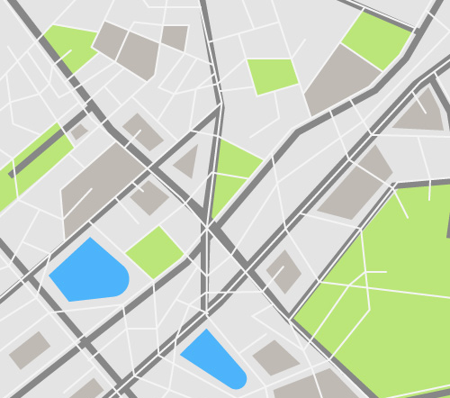
Future Scope
Real-time updates: Enhance route optimization by integrating real-time traffic data for dynamic adjustments.
Smart transportation integration:Integrate with emerging smart city technologies for predictive routing and adaptive traffic management.
Multi-modal collaboration:Expand collaboration with other transportation modes for seamless interconnectivity and enhanced urban mobility.
Policy implementation:Work with city authorities to implement optimized routes as part of broader urban planning initiatives for sustainable development.

Slide 9
Thank You!

